Slide 1


PROJECT MEMBERS
Gourishankar Hosur
Panchali Das
Urmila Vanjare
Priti Vartak
Prabhudatt Rana
Shubham Chavan

Slide 2

Objective
Thorough understanding of the attrition trends.
To identify patterns and potential factors that contribute to attrition.
Potential implications and strategies for addressing attrition.
Building dashboard - will elevate simple metrics, by linking them to one another and visualizing them as a whole.

Slide 3
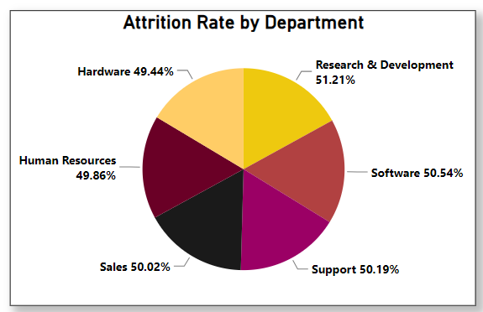
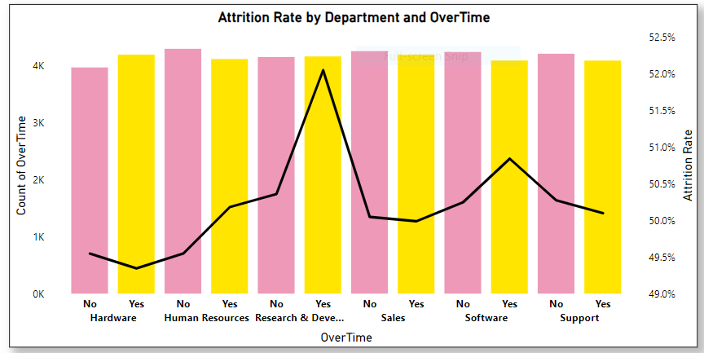

KPI 1 – Average Attrition Rate for all Departments
OBSERVATION:
A consistent attrition rate across almost all departments.
This can be seen as a positive aspect, as it indicates that the organization is maintaining a certain level of employee satisfaction and engagement across the board.
Room for improvement in Research & Development and Software department.
IMPACT:
Extended work hours over a prolonged period can contribute to burnout and reduced job satisfaction, potentially influencing attrition rates.
RECOMMENDATIONS:
Evaluate project timelines and resource allocation.
Fix abnormally high overtime hours by hiring and training new workers.

Slide 4
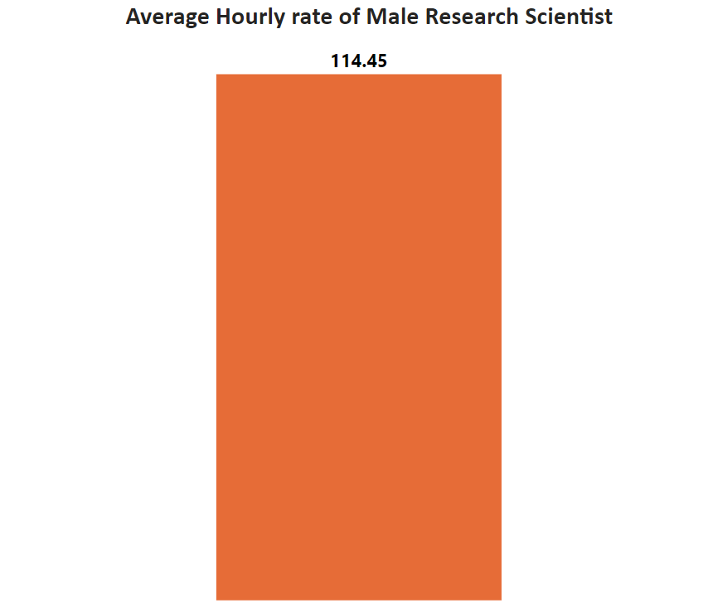
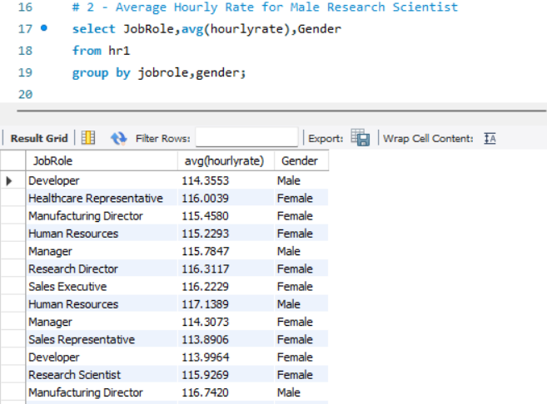

KPI 2 – Average Hourly Rate of Male Research Scientist
Observation:
Average hourly rate for all depart is almost similar.
For male research scientist is 114.45
Sales representative have lowest hourly rate.
Male have lowest hourly rate compare to women.
Less the hourly rate high the attrition rate.
Conclusion:
If we want to decrease the attrition rete we hove to improve Hourly rate for all department.
In each department if the attrition rate is high and hourly rate is also high then improve the others aspects.

Slide 5
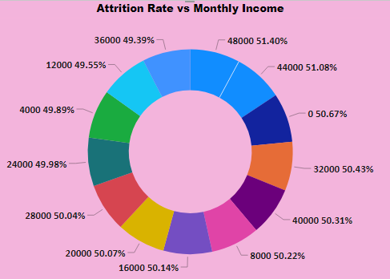

KPI 3 – Attrition Rate vs Monthly Income
Observations:
Attrition rates show minor variations around 50% across monthly income bins, suggesting balanced turnover, with consistent patterns but no clear linear correlation, visually depicted in the chart.
Trends & Fluctuations:
Attrition rates exhibit fluctuating but generally stable trends across income bins without a consistent upward or downward pattern
Possible Reasons:
Possible reasons for attrition include job dissatisfaction (roles, culture, growth), market demand enticing better offers, and potential salary concerns (though not clearly indicated by data alone).
Potential Changes:
Recommended actions involve salary analysis for competitiveness, exit interviews to uncover reasons, and implementing retention programs like career development and mentorship.

Slide 6
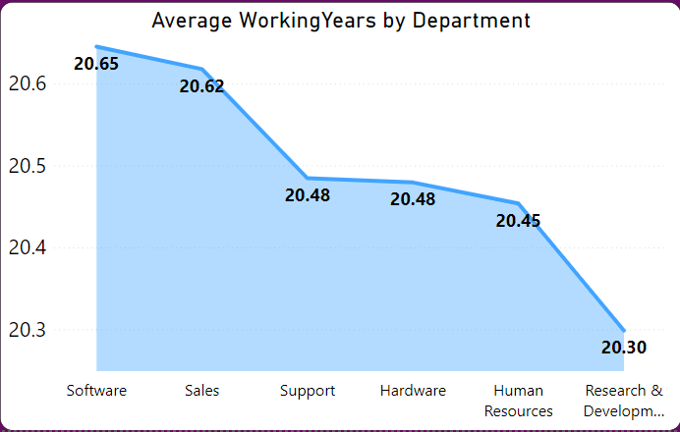

KPI 4 – Average Working Years for Each Department
Due to rapid growth in salary and rapidly evolving technology younger generation prefer to spend more years in software.
R &D employees spend lesser years as very less people develop ability to research and develop new technologies
Working in Sales employees receive additional commissions for their hard work. Their job involves interacting with their clients.
These differences in working years are also found due to industry trends, company practices, and geographic location.

Slide 7
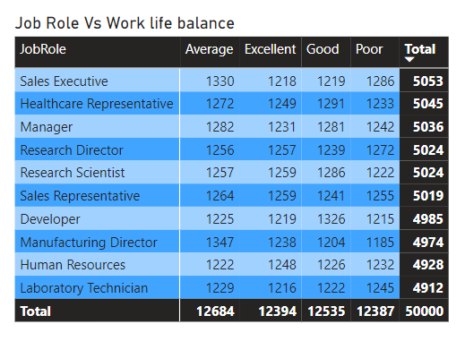
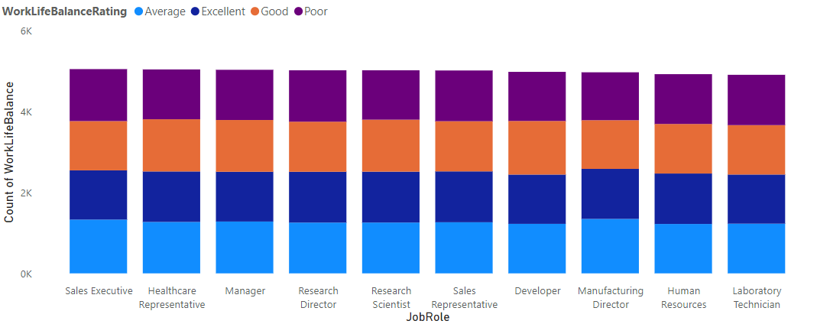

KPI 5 – Job Role vs Work Life Balance
.
As per our observation, the work life balance of all department is approximately same except some departments.
.
In conclusion, the pursuit of a balanced life is not a compromise but a strategic investment. It's a recognition that personal growth, relationships, and rejuvenation are foundational to excelling in any job role.

Slide 8
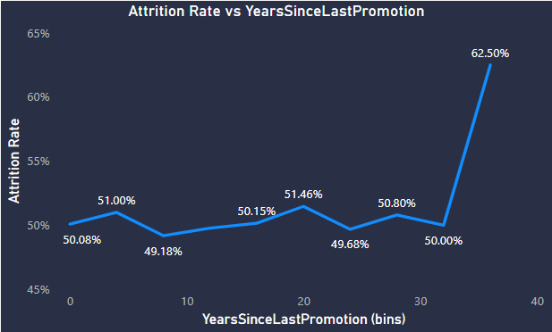

KPI 6 - Attrition Rate vs Years Since Last Promotion
.
Attrition Variation: The attrition rates vary within a relatively narrow range, from around 49.18% to 62.50%. This suggests that the overall attrition rate is not drastically changing with the years since the last promotion.
.
Inconsistent Trend: At first glance, there isn't a clear linear or
consistent trend in attrition rate as years since last promotion increase.
.
Other Factors: It might be worth considering other factors that could influence attrition, such as job role, department , Monthly Income , Work Life Balance , and overall job market conditions.
Conclusion : Even though there is no clear relation between attrition and years since last promotion and there may be other factors that could be influencing attrition , like I mentioned above . We can conclude that employees getting promoted early are not leaving the company , so company should promote employees within 10 year period to avoid employees leaving the company.

Slide 9


